Slide 1

T.I.G.E.R.
#9 Haemorrhage Control in Trauma patients
Version: 1.0
Review date: 05/25
This Guidance is intended to provide “one safe way” of approaching Haemorrhage control in trauma patients. It is not an algorithm and is intended to support the practice of a clinician with sufficient knowledge and experience to understand when it is not applicable to the patient they are managing and when to seek additional support from a more experienced trauma specialist. It is not for use in paediatric patients.
Situation
Trauma patient with haemorrhage in the Emergency Department Resuscitation Area.
Clinician trained in trauma management and leadership.
A trauma team present consisting of Senior Orthopaedic, Surgical and Airway trained support.
Consultant aware and able to provide immediate support if required
Blood bank and theatres available via a Major haemorrhage call if required.
Patient
Patients who have suffered a traumatic mechanism of injury may demonstrate haemorrhagic shock in a variety of signs and symptoms:
A mechanism consistent with serious injury
Injuries on examination compatible with major bleeding
Physiology evolving in an appropriate timescale
Hypotension or an unrecordable BP or high readings with extremely narrowed pulse pressures
Pallor, sweating, cold peripheries, poor SpO2 waveform
Absence of peripheral venous filling (difficulty to cannulate)
Air hunger
Abnormal cerebration – agitation, confusion, apathy or unconsciousness
Low or falling ETCO2
The heart rate may be high, low or normal
Obstructive causes of shock should be excluded
Where haemorrhage is suspected or confirmed and the SBP <90mmHG at any time and doesn’t respond to fluid then in accordance with the local trust policies Major haemorrhage activation calls should be placed at the earliest opportunity.
This TIGER is based on LAA Haemorrhage and vascular access SOP

Slide 2

Haemorrhage control
Every effort should be made to minimise blood loss and maximise clot formation
Full Exposure
  Ensure removal of clothing in order to identify any areas of bleeding
Careful patient handling
  Aims to minimise clot disruption
Fracture Reduction/Splintage
  All long bones drawn out to length and splinted. Pelvic fractures should have a binder applied. This reduces soft tissue volume to bleed into.
Limb injuries
  Point pressure applied at the site of bleeding is a better haemorrhage control measure than generalised pressure and should be used if able. Celox gauze should be available to use. Sutures or staples may be required to facilitate haemostasis. If manual pressure fails to control blood loss a combat application tourniquet should be used. These must be applied tightly. Two CATs on one limb may be required in some cases. The time of tourniquet application must be recorded.
Junctional Injuries
  Should be considered non-compressible. Wound packing with Celox gauze should be available and considered. Ongoing bleeding may be continuing internally despite the impression of external haemostasis. Early consideration of surgical wound exploration should be considered in a theatre setting able to manage the patient. Consider critical transfer to the MTC for junctional wounds where haemorrhage control has been difficult.
Maxillofacial injuries
  These can be difficult to control. Secure the airway, Manually restore anatomical normality if needed, Placement of appropriately sized dental blocks, Placement of Cervical spine collar to maintain mandibular splinting, Placement of Epistats.
Penetrating objects in situ
  Retained foreign objects may be causing a tamponade effect on vascular structures internally. The decision to remove these should be after senior discussion and ideally in a theatre controlled environment. In a cardiac arrest situation the object should be removed if causing obstruction to care.
Vascular Access
Standard access should consist of a 14 or 16 gauge cannula in the upper limbs with two in haemorrhagic shock. Where able these should be in a uninjured arm without ipsilateral chest injuries.
These lines should be secured with tape and bandaging.
Where peripheral vascular access is not able to be achieved a trauma line should be inserted, ideally into the subclavian vein (These should only be placed by a clinician trained in their placement.)
Intraosseous access can be used to deliver urgent drugs, however they can often be misplaced or dislodge and can be unsuitable to deliver large volume rapid transfusions.
Blood tests should be taken with any intravenous device (FBC, U&E, LFT, Clotting, Crossmatch, VBG).

Slide 3
The decision to administer blood in a shocked patient is influenced by several factors: injury type, likelihood of ongoing bleeding, degree of shock, patient comorbidities, time to definitive care and the need for anaesthesia and ventilation. Evidence suggests some patients will benefit from early transfusion and prolonged or severe hypotension may worsen coagulopathy, bleeding and multi-organ failure.
The Exsanguinating patient (Category 1)
A patient with apparent major injuries and a significant mechanism, low BP and agonal. Urgent haemorrhage control with aggressive transfusion is required to prevent deterioration.
Isolated non-compressible major haemorrhage (Category 2)
Definitive care is paramount. Transfusion should target cerebral perfusion with minimal intervention unless severe deterioration.
Polytrauma bleeding patient without TBI (Category 3)
Multiple injured patient with a high suspicion of ongoing bleeding but minimal/no evidence of head injury. May need a high BP trigger point if the patient is poorly tolerating hypotension
Polytrauma bleeding patient with TBI (Category 4)
Multiple injured patient with a high suspicion of ongoing bleeding and evidence of a significant traumatic brain injury. A higher target is aimed to improve Cerebral Perfusion Pressures.
Compressible or controlled haemorrhage (Category 5)
If haemorrhage is controlled then treat shock whilst optimising time to definitive care. Blood is the fluid choice – crystalloids impair coagulation in trauma. Colloids must not be used for trauma resuscitation.
Non-Haemorrhage (Category 6)
This includes bleeding mimics such as neurogenic shock or other causes of vasodilation/volume depletion (alcohol). Ensure re-evaluation has been conducted to rule out haemorrhage
Blood Administration
Category | Description | Fluid Choice | Transfusion trigger
1 | Exsanguination | Blood | Immediately
2 | Isolated major non-compressible bleeding | Blood | Verbal contact/ 60-70mmHg/ Central pulse
3 | Polytrauma bleeding with no TBI | Blood | 80-100mmHg
4 | Polytrauma bleeding with TBI | Blood | 100 – 120mmHg
5 | Compressible/ controlled | Blood or 0.9% Saline | 100-120mmHG
6 | Non- haemorrhage | 0.9% Saline +/- Inotropes | Situation specific

Slide 4

Tranexamic acid
  Demonstrated to reduce the risk of death in a bleeding trauma patient in a time dependent fashion.
Sedation/Analgesia
  Patient specific choices, should be provided be a trained individual to aid in haemorrhage control where appropriate
Calcium Chloride
  Patients receiving blood transfusions should also receive calcium as part of their local trust policy. Calcium is essential for both cardiovascular homeostasis and haemostasis and is worsened by blood transfusion.
Anticoagulant reversal
  Consideration of INR testing and anticoagulant reversal should be considered dependent on patient history and in accordance with local trust policy.
Drug Administration
Escalation & Support
Escalate locally through activation of a Trauma call or Major Haemorrhage to obtain early support
Early Consultant escalation and involvement will aid in senior decision making
Specific surgical advice will be arranged by the MTC if required.
Clinical support is available through the Major Trauma Receiving Consultant at The Royal London Hospital on 020 3594 5722

Slide 5
Suggested Equipment Available to Clinicians managing haemorrhaging trauma patients
Monitoring
Resuscitation bay with cardiac monitoring
    Trauma Shears
Access
    Intravenous Cannula, fixation devices and bandages– Sizes 14g/16g/18g
    Trauma line – 9Fr
    Intraosseous device, needles and fixation device
Haemorrhage control devices
    Pelvic binder
    Kendrick traction device
    Sterile Gauze, Blast dressings, Celox Gauze
    Combat application torniquet
    Suturing Kit and Sutures (1.0, 2.0)
    Staple gun
    Surgical Chest drain kit including 32Fr drain
    Thoracotomy kit
    Foley catheter
    Maxillofacial haemorrhage equipment (Refer to TIGER #? – OMFS Injuries)
Airway
    Oxygen, non-rebreather masks, airway adjuncts.
    Fully stocked Intubation Trolley
Drugs
    Timely access to Blood products
    Bedside Blood warming device
    Tranexamic Acid
    Analgesia and sedative drugs
    Calcium chloride
    Anticoagulant Reversal agents
Radiology
    Timely Access to Xray and CT facilities. Consideration of Interventional Radiology where appropriate and available.
Surgical theatre
    Timely Access to theatre and appropriate surgical capabilities
Equipment
Tranexamic acid
  Demonstrated to reduce the risk of death in a bleeding trauma patient in a time dependent fashion.
Sedation/Analgesia
  Patient specific choices, should be provided be a trained individual to aid in haemorrhage control where appropriate
Calcium Chloride
  Patients receiving blood transfusions should also receive calcium as part of their local trust policy. Calcium is essential for both cardiovascular homeostasis and haemostasis and is worsened by blood transfusion.
Anticoagulant reversal
  Consideration of INR testing and anticoagulant reversal should be considered dependent on patient history and in accordance with local trust policy.

Slide 6
Interventions: Pelvic Binder
Background
Pelvic fractures are typically associated with high energy trauma and haemodynamic instability
Three main fracture patterns
  Anterior-Posterior Compression – often ligamentous injuries at the Pubic symphysis of SI joint (open book). Fractures can be complicated by vascular injury with the pelvic volume significantly increased in these injuries. E.g. crush injury front to back/ head on RTC.
  Lateral compression – lateral compression of the pelvis causes inward rotation of the hemi-pelvis and instability. E.g. side impact RTC or fall on to one side
  Vertical Shear – energy transmitted through one limb and one side of the pelvis during injury. E.g. Falls from height
Indication
Suspected Pelvic Ring fractures which may result in haemodynamic instability
Mechanism
Provides circumferential external compression
  Reducing the volume of the pelvis to enable earlier tamponade
  Provide skeletal stabilisation, reducing pain and reducing disruption of clot
  formation
How to place
You should be familiar with the equipment prior to use
A pelvic binder should be applied directly to skin
Minimise patient handling to minimise clot disruption
Limit patient rolling to 15 degrees
Place the binder under the patient
The splint mid point should sit over the femoral greater trochanters
The straps are tightened together until the pelvis is reduced. You should be able to place two fingers between the belt and the patient to avoid over-tightening.
Ensure no entrapment of genitals or debris
Removal
It should only be removed in a controlled clinical environment where other means of stabilisation/ splintage have been initiated or after full radiological imaging has excluded instability or clinical benefit. This should be a senior clinical decision with
A repeat pelvic XR once the binder has been removed should be considered
Risks
Incorrect placement can increase bony displacement – particularly lateral compression fractures
Pressure necrosis of underlying skin/soft tissue - Ensure timely expedition of definitive management to minimise the duration of application
Genital injury - Ensure avoidance of entrapment during placement

Slide 7
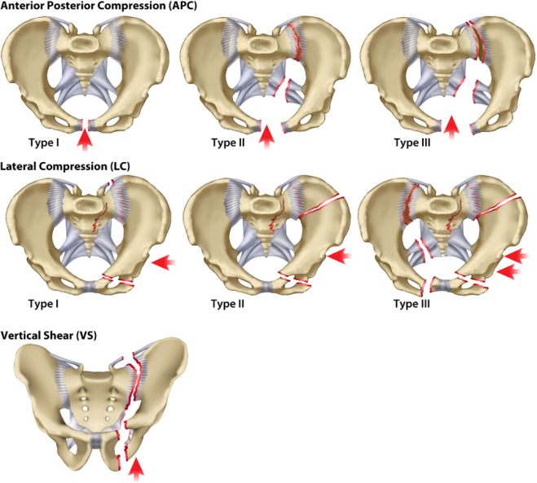
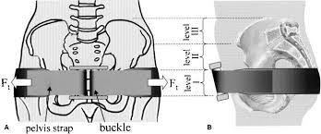
Interventions: Pelvic Binder

Slide 8
Interventions: Kendrick Traction Device
Background
A fracture of the femur can occur in both high and low energy incidents depending on factors such as a patients age or comorbidities. This injury can cause significant haemodynamic instability from haemorrhage.
Indication
Fracture of a femur – either open or closed
Contradictions
The use of this device should not be used where there are fractures of the ankle or foot, or a partial amputation/avulsion where there is only marginal tissue connecting the distal limb
Mechanism
Reduction of a displaced closed or displaced open fracture allows:
  Analgesic benefit from fracture splintage
  Reduction in the volume of space for a fracture to bleed in to
How to place
You should be familiar with the equipment prior to use
If the patient requires a pelvic binder then that should be applied prior to application of a Kendrick Traction device
Clothing and footwear should be removed
Ensure analgesia/sedation has been given to the patient
Apply the ankle hitch tightly around the leg, above the ankle joint. Tighten by pulling the green tab strap until tight under the heel
Apply the upper thigh belt, ensuring the buckle is located anteriorly to the patient and the pole holder is located laterally at the level of the pelvic crest. Ensure no entrapment of genitals
Ensure the pole is extended and each joint is secured. Ensure the length is one section distal to the foot. Place this in the upper thigh belt pole holder. Secure the elastic strap at the knee level
Place the yellow tab ankle strap on the bar at the end of the pole
One individual should apply traction to the leg until fracture reduction is obtained. Another individual should tighten the red tab strap until tight to maintain the traction in place
Finish the packaging by applying the upper leg and lower leg straps
Ensure Neurovascular status is checked post manipulation and thereafter ongoing according to local poicy
Removal
Should be removed if the patient has no radiological proven fracture
Once an alternative method of splintage/ fixation is placed/ made available
Risks
Skin/ Soft tissue necrosis, incorrect placement and Neurovascular injury
Tranexamic acid
  Demonstrated to reduce the risk of death in a bleeding trauma patient in a time dependent fashion.
Sedation/Analgesia
  Patient specific choices, should be provided be a trained individual to aid in haemorrhage control where appropriate
Calcium Chloride
  Patients receiving blood transfusions should also receive calcium as part of their local trust policy. Calcium is essential for both cardiovascular homeostasis and haemostasis and is worsened by blood transfusion.
Anticoagulant reversal
  Consideration of INR testing and anticoagulant reversal should be considered dependent on patient history and in accordance with local trust policy.

Slide 9
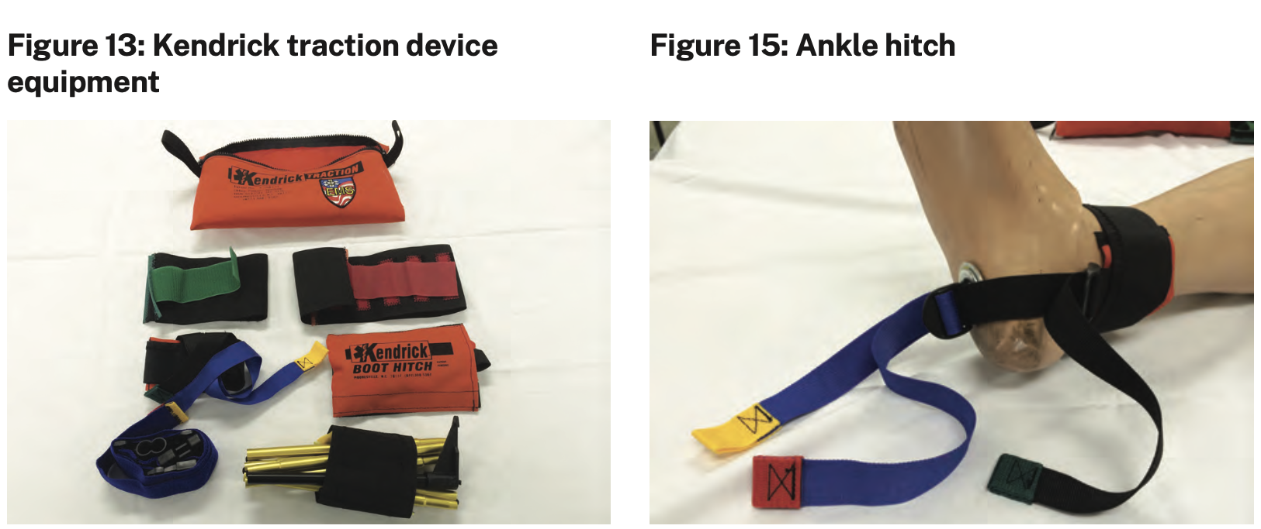
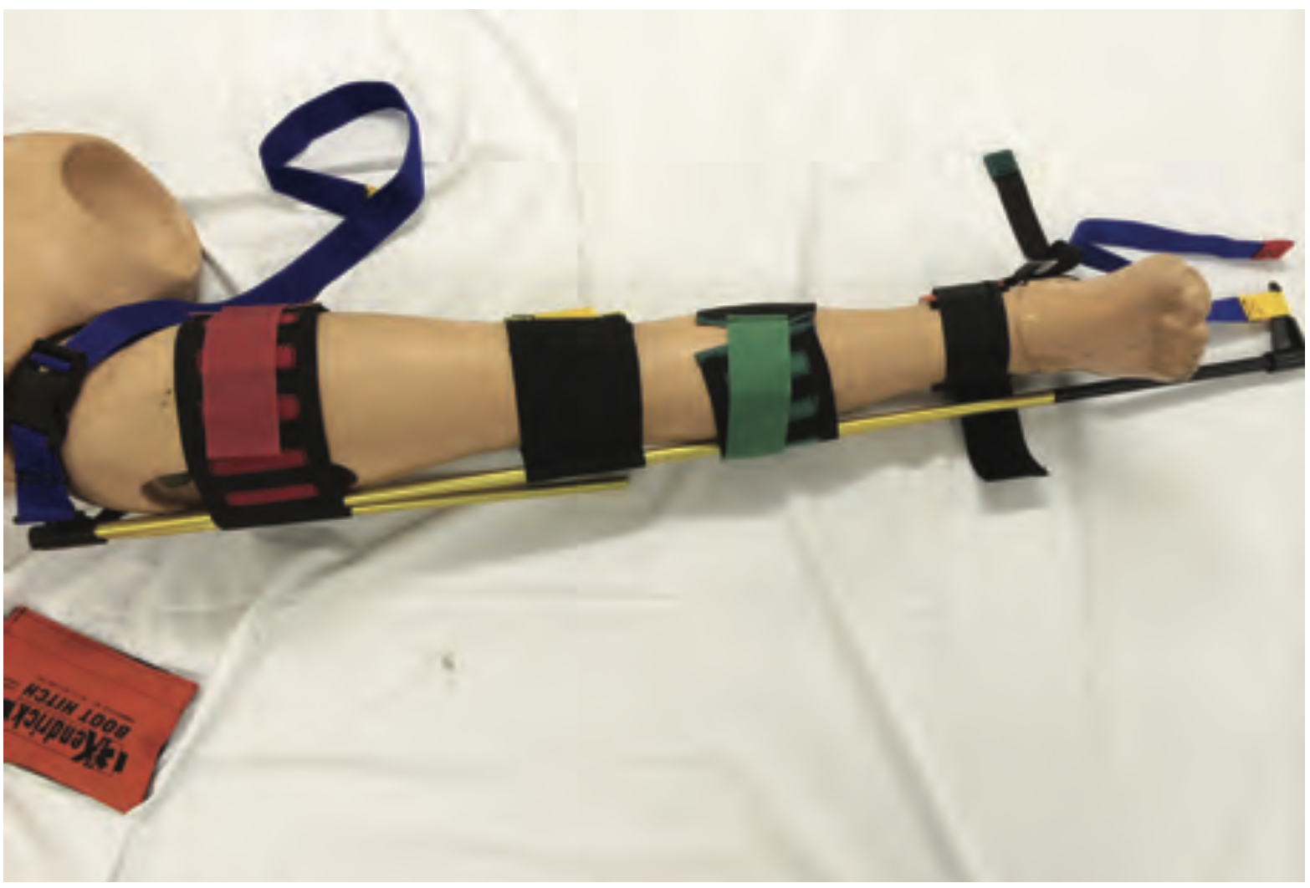
Interventions: Kendrick Traction Device
Equipment required
Ankle hitch
Tranexamic acid
  Demonstrated to reduce the risk of death in a bleeding trauma patient in a time dependent fashion.
Sedation/Analgesia
  Patient specific choices, should be provided be a trained individual to aid in haemorrhage control where appropriate
Calcium Chloride
  Patients receiving blood transfusions should also receive calcium as part of their local trust policy. Calcium is essential for both cardiovascular homeostasis and haemostasis and is worsened by blood transfusion.
Anticoagulant reversal
  Consideration of INR testing and anticoagulant reversal should be considered dependent on patient history and in accordance with local trust policy.

Slide 10
Interventions: Torniquet
Background
Tourniquets should be used only as a last resort after stepwise haemorrhage control, apart from a complete traumatic amputation where a tourniquet should be applied.
Correct application is vital as incorrectly applied tourniquets can cause increased bleeding
Tourniquets can be applied over two bones
Indication
Life threatening extremity haemorrhage that is not controlled by direct pressure and a haemostatic dressing
Mechanism
Once correctly applied they will occlude arterial blood flow from the application of external compression
How to place
You should be familiar with the equipment prior to use
Apply directly to the skin to prevent it slipping
Apply proximal to the wound (try to aim for at least 5cm space) but apply as distal as possible on the limb (to increase the maximum amount of salvageable tissue)
Apply the tourniquet tightly by tightening the windlass mechanism after securing the Velcro strap. The effectiveness of the tourniquet will be determined by the cessation of external haemorrhage and not by the presence/absence of a distal pulse.
A second tourniquet may be required (proximal to the first) if on-going bleeding.
Record the time that the tourniquet is applied – on the device and ensure handed over to the surgical or transfer team/recorded in the notes
Once applied care should be expedited to definitive treatment/cessation of bleeding via transfer or theatre
Ensure sufficient analgesia/sedation
Removal
After application of a tourniquet the patient should received definitive care to facilitate removal of the tourniquet by 120 minutes
Prolonged tourniquet application has an associated risk of local and systemic reperfusion effects, rhabdomyolysis, compartment syndrome and hyperkalaemia
Ischaemic tourniquet time should be less than 120 minutes after application
Risks
If incorrectly applied tourniquets may cause increased bleeding distally via occlusion of venous outflow but inadequate arterial occlusion
Prolonged application more than 120 minutes is associated to significant complications
Applied too proximal may reduce salvageable tissue
Significant pain

Slide 11
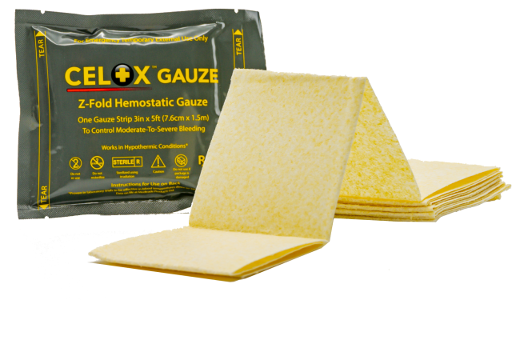
Interventions: Celox Gauze
Background
Celox is a brand of chitosan containing gauze. Chitosan is a haemostatic agent that promotes clot formation.
It is not toxic and does not cause an exothermic reaction.
It is derived from shellfish and allergy studies have shown no adverse reactions
Indication
External use to control compressible life-threatening emergency bleeding where a simple dressing and pressure has not been successful
It should be used as a temporary haemorrhage control method whilst definitive control is being conducted/arranged.
Mechanism
Chitosan is a haemostat agent that promotes clot formation.
How to place
Application of Celox gauze is a two person technique
The first person should be applying pressure to the wound with a dressing
The second person should unpack and unravel the Celox gauze – this should be inserted via packing the wound tightly. It should be applied aiming for point pressure to the bleeding area
Following placement of Celox there should be pressure applied on top for at least three minutes
Celox gauze is a temporary haemorrhage control method and thus definitive control should be planned and expedited
Removal
Should only be removed when definitive haemorrhage control is about to be obtained
The wound should be irrigated
Risks
Do not apply to eyes
Single use item
Must be ensured it is removed prior to wound closure
Tranexamic acid
  Demonstrated to reduce the risk of death in a bleeding trauma patient in a time dependent fashion.
Sedation/Analgesia
  Patient specific choices, should be provided be a trained individual to aid in haemorrhage control where appropriate
Calcium Chloride
  Patients receiving blood transfusions should also receive calcium as part of their local trust policy. Calcium is essential for both cardiovascular homeostasis and haemostasis and is worsened by blood transfusion.
Anticoagulant reversal
  Consideration of INR testing and anticoagulant reversal should be considered dependent on patient history and in accordance with local trust policy.

