Slide 1


T.I.G.E.R.
#7 US-guided Fascial Plane Blocks
Version: 1.0
Review date: 05/25
This TIGER represents one safe way of providing ultrasound guided fascial plane blocks. It has been adapted accordingly for local use at ___________________ Hospital on the ___/___/____
Ultrasound-guided fascial plane blocks (UGFPBs) are part of the multimodal approach to the treatment of acute pain in the ED. UGFPBs have the potential to provide fast, direct and prolonged analgesia with fewer systemic side effects compared to procedural sedation or systemic analgesia. Ultrasound guidance allows clinicians to visualize the target structures (nerve and fascial planes), the advancing needle and surrounding structures to guide accurate needle tip placement adjacent to the nerve.
Situation
Trauma patient in the Emergency Department Resuscitation Area
Nerve-block equipment at bedside
Intralipid emulsion readily available in the antidotes cupboard
Clinician trained and experienced in US-guided nerve blocks
Consultant aware that procedure is taking place and available to provide immediate support if required (EM/Anaesthesia/ICM)
Patient
Patient with fractures/wounds/burns and at least one of the following criteria:
Drug-sparing analgesia preferred over systemic analgesia (elderly, increased risk of delirium, multiple comorbidities, etc.)
Need for fracture manipulation/wound exploration and contraindications (relative or absolute) to procedural sedation
Equipment
This procedure should be carried out in the resuscitation area
See attached list of equipment
Use attached US-guided nerve block procedural checklist
Intralipid emulsion must be immediately available

Slide 2
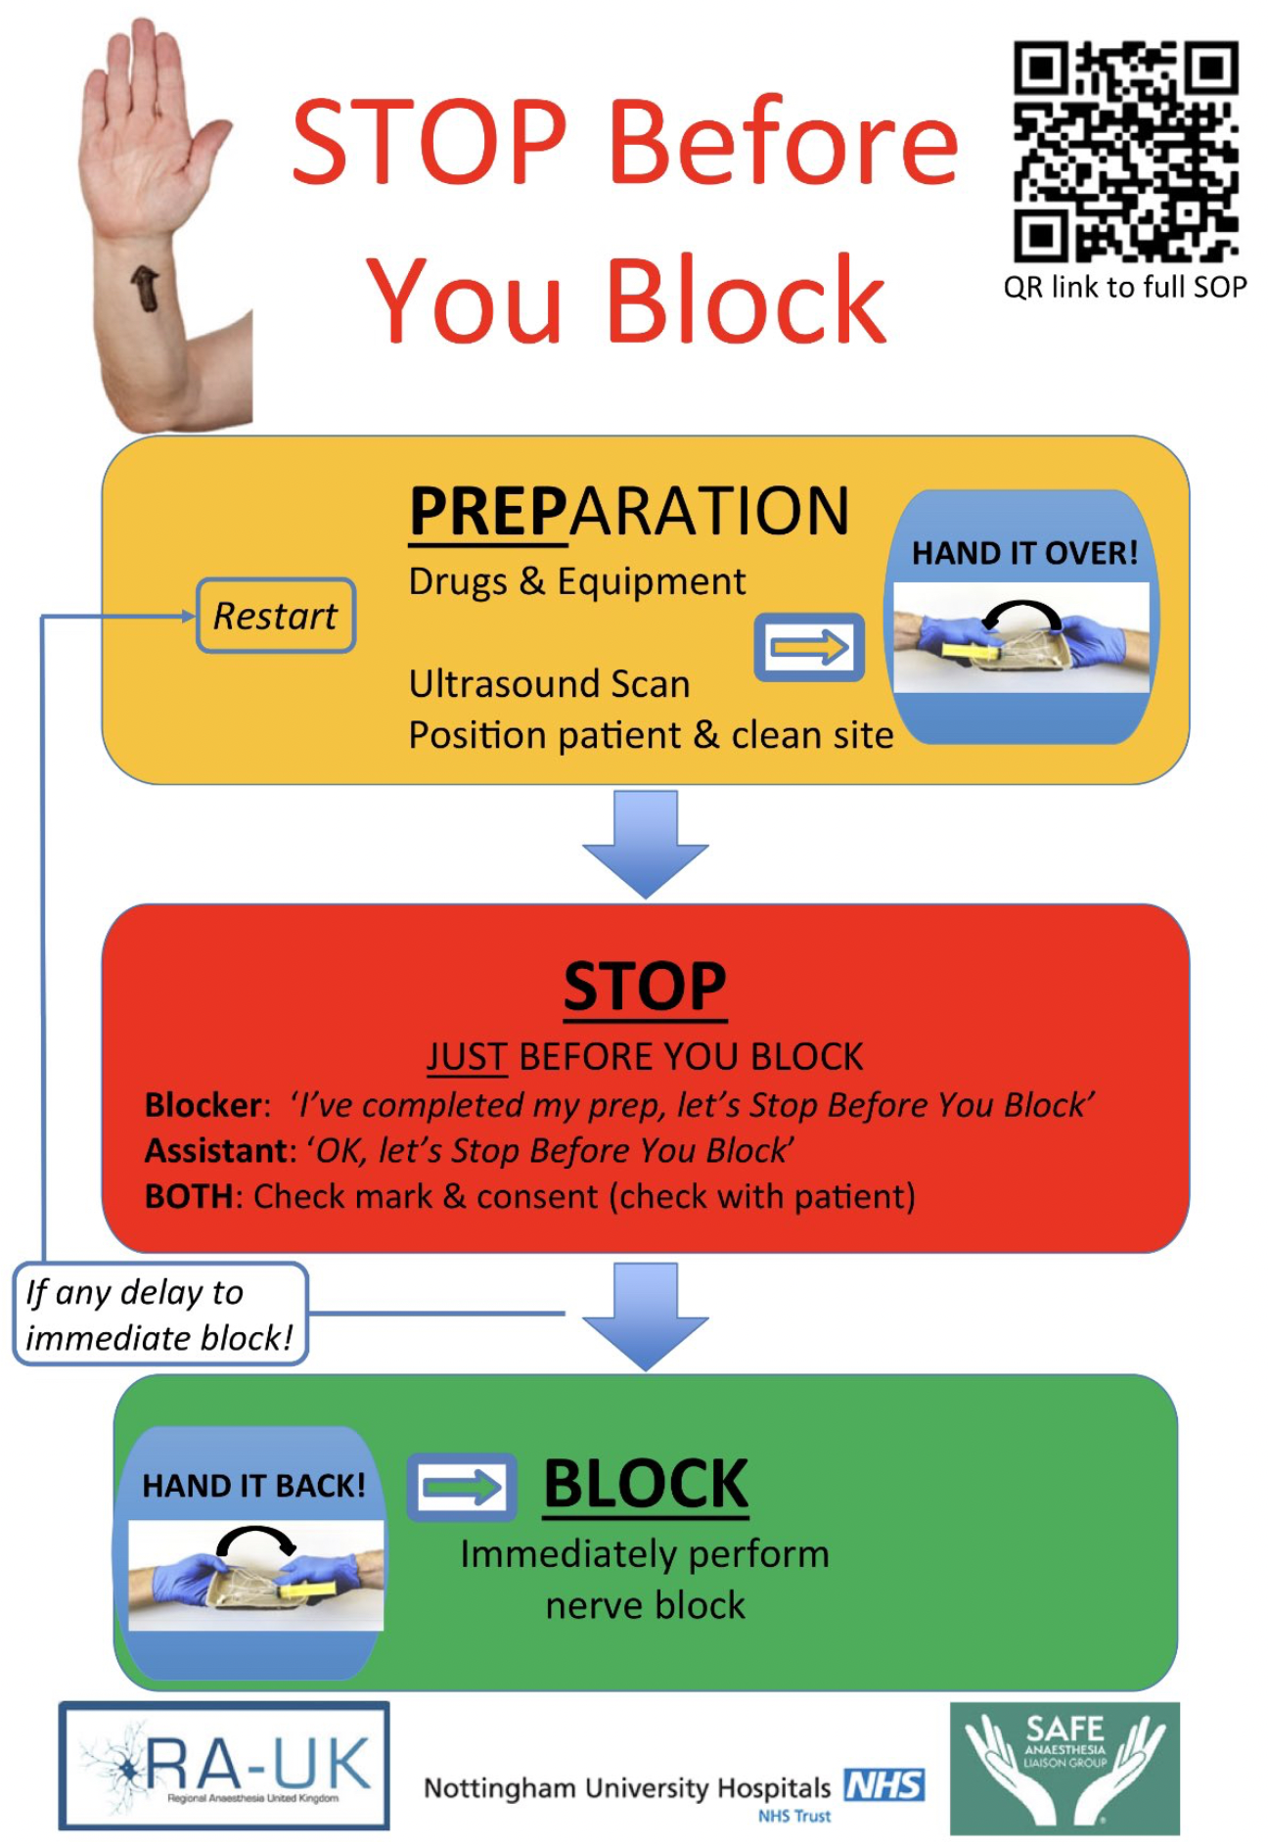

Slide 3


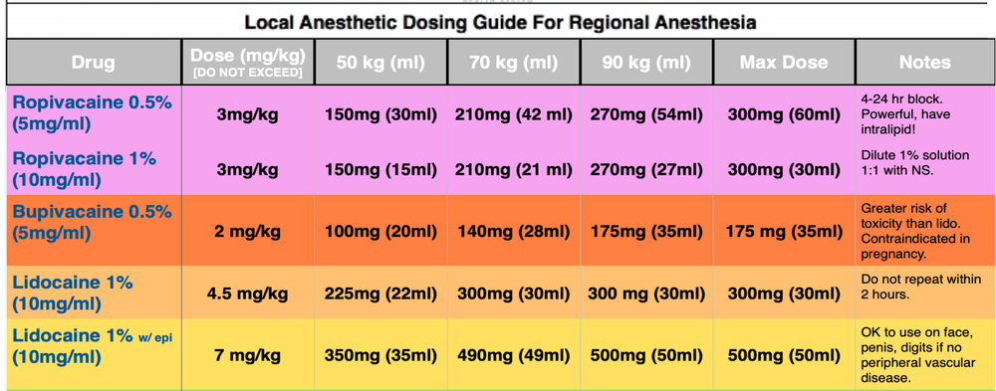
PROCEDURE
#7 US-guided Fascial Plane Blocks
Preparation
Ensure nerve-block equipment (FIB-pack, local anaesthetic) is available
Ensure intralipid emulsion is available
Put patient on cardiac monitor
Ensure US machine is at bedside, charged and with correct set-up (high-frequency linear probe, MSK pre-set). Relative position of the patient, the US machine and the operator should be optimised before the procedure
Use sterile US probe cover and sterile gel
Confirm dose of local anaesthetic administered with two-person verification
Allocate roles: prefer a two-person technique in which one provider advances the needle tip under US-guidance, and the other injects the local anaesthetic through an attached catheter
Induction
1 x Intravenous access, large bore where possible, ensure lines flush and that fluids are attached
Attach monitoring: ECG, NIBP, Sats
Local anaesthetic toxicity is a considerable risk – intralipid emulsion and emergency drugs must be available and a strategy discussed to manage this before procedure commences
Local anaesthetic: ropivacaine is the preferred choice for the majority of procedures

Slide 4
PROCEDURE
#7 US-guided Fascial Plane Blocks
Procedure
Use a 2-person technique
Optimise patient position
Confirm limb and site
Turn on US machine and choose appropriate setting (high-frequency linear probe, MSK pre-set)
Optimise US machine position relative to patient and operator
Change into sterile gloves/gown
Prepare skin with chlorhexidine
Set up sterile field
Set up sterile sleeve onto the liner probe
Draw up desired amount of local anaesthetic – two-person verification
Hand correctly labelled 20mls syringe (NRFit) with local anaesthetic to second operator
Perform survey scan to help locate anatomical landmarks
Place a 1-2ml skin wheal of local anaesthetic next to the probe at desired needle entry point
Use in-plane, US-guided technique to advance needle
Maintain visualization of needle tip throughout the procedure; if needle tip is not correctly visualised: stop, withdraw, optimise view and reposition
When desired position/target structure reached ask second operator to aspirate to avoid intravascular injection of local anaesthetic
Ask the second operator to inject 3-5mls of local anaesthetic
If needle fluid spreading not satisfactory, stop and try reposition needle tip
When satisfactory needle tip position reached, ask second operator to repeatedly inject small aliquots (3-5mls) of local anaesthetic (aspirating between injection to avoid unintended intravascular administration of local anaesthetic)
Repeat until desired amount of local anaesthetic injected
Withdraw needle and dress skin

Slide 5

EQUIPMENT
#7 US-guided Fascial Plane Blocks
Bedside monitor
Sterile gloves and gown for the operator
Skin prep (Chlorhexidine 2%)
US machine (charged and with adequate probe and pre-set selected)
Local anaesthetic of choice (dose calculated and checked with 2-person verification)
Sterile peripheral-nerve block pack (NRFit):
  Sterile US probe sleeve and sterile gel
  20 mls syringe to draw up local anaesthetic
  Syringe extension to connect syringe to nerve block needle
  20-22G Nerve Block needle (or spinal needle)
  Small dressing
CHECKLIST
#7 US-guided Fascial Plane Blocks
This is designed as a challenge-response checklist in which the operator should be responding to the questions.
Correct patient (Give name & MRN) CHECK
Correct limb & side (State location) CHECK
Sterile field and skin prep available CHECK
US machine charged, correct position/probe/pre-set CHECK
Sterile US probe sleeve and sterile gel available CHECK
Nerve block needle/connector/20mls syringe available (NRFit) CHECK
Local anaesthetic (Give intended regime & allocate drug giver) CHECK
Emergency drugs available CHECK

Slide 6
Types of UPNBs
#7 US-guided Fascial Plane Blocks
Fascia Iliaca Compartment Block (FIB)
Indications
Proximal femoral fractures
Patella fractures and its tendon injuries
Anatomy
Femoral nerve arise from L2-4 before descending over the iliopsoas muscle
The femoral nerve sits laterally to the femoral artery and vein
Fascial plane overlying the iliopsoas muscle (fascia iliaca) serves as a critical landmark when performing an ultrasound-guided block
Aim of the block is to gently inject local anaesthetic under this fascial plane and bathe the femoral nerve in it
Obturator nerve originates at the L2-4 ventral rami but descends more medially - it is variably blocked by the UGFNB.
Survey Scan
Patient in a supine position
High-frequency linear transducer placed below and parallel to the inguinal crease
Locate the femoral artery and vein in cross-section
Femoral nerve just lateral to the vascular bundle and below the fascia iliaca
Technique
Prep skin with chlorhexidine (or similar skin cleanser)
Place a 1-2 mL skin wheal of anaesthetic lateral to the probe
Nerve block needle advanced with an in-plane lateral to medial approach, advance the needle tip under the fascia iliaca
Aspirate to avoid intravascular injection of local anaesthetic
Inject 3-5 mL of local anaesthetic: fluid should be visible spreading under the fascia iliaca
Anaesthetic solution can then be gently injected in 3-5 mL aliquots (aspirating in between each dose to ensure a lack of inadvertent vascular puncture) until the desired volume is reached

Slide 7
Types of UPNBs
#7 US-guided Fascial Plane Blocks
Serratus Anterior Fascial Plane block (SAPB)
Indications
Pain control for acute rib fractures, burns, chest wall abscesses, and thoracic zoster
Anatomy
The intercostal nerves derive from the anterior rami of the thoracic spinal nerves and travel laterally along the hemithorax within the intercostal muscles. In the mid-axillary line, the lateral cutaneous branches pierce the internal and external intercostal muscles to innervate the muscles and skin of the lateral and anterior hemithorax. The SAPB deposits local anaesthetic into the fascial plane either superficial to the serratus anterior muscle, between the latissimus dorsi and serratus anterior muscles, or deep to the serratus anterior muscle, between the serratus anterior muscle and intercostal muscles and rib. Pain relief for rib fractures is thought to occur through the spread of local anaesthetic along these penetrating branches deep to the intercostal nerves. The latter approach is useful in elderly patients, whose muscular layers are poorly defined.
Survey Scan
Patient lying laterally
The SAPB can be performed with the patient either in the lateral decubitus position or supine (if unable to roll due to concurrent cervical, spinal, or extremity injuries). When performing the block with the patient in the lateral decubitus position (affected side up), the provider should be behind the patient with the ultrasound system contralateral and in direct line of sight. The needle trajectory will be posterior to anterior on the patient.
Patient lying supine
In the supine position, the provider stands on the ipsilateral side of the injury near the patient's head with the ultrasound system caudal. With this positioning, the needle will travel anterior to posterior on the patient.
Thoracic level of the block targeted at the midpoint of the identified fractures (fractures at T6-10 → level of injection at T8)
Linear transducer placed in transverse orientation at the selected level at the mid-axillary line
Serratus anterior muscle is the muscular layer superficial to the ribs
At the posterior axillary line, superficial to the serratus anterior is the tapering lateral border of the latissimus dorsi muscle
Technique
Prep skin with chlorhexidine (or similar skin cleanser)
Place a 1-2 mL skin wheal of anaesthetic lateral to the probe
Nerve block needle advanced with an in-plane US-guided technique to the intermuscular plane between the latissimus dorsi and the anterior surface of the serratus anterior muscle (superficial approach) or between the serratus anterior muscle and intercostal muscles and ribs (deep approach).
Aspirate to avoid intravascular injection
The assistant inject 3-5 mL of local anaesthetic: fluid will spread laterally and open up this potential space.
Perform slow injections in aliquots of 3-5 cc (aspirating in between each dose to ensure a lack of inadvertent vascular puncture) until the full volume of local anaesthetic has been deposited into the fascial plane

Slide 8
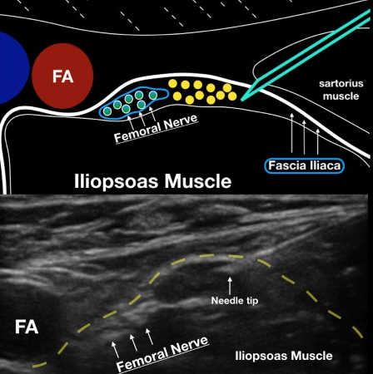
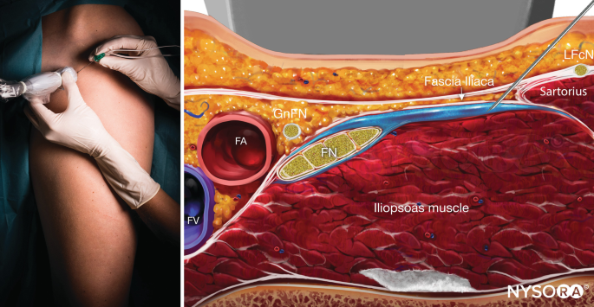
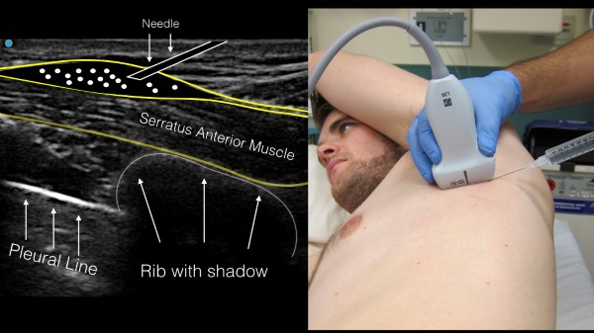
Types of UPNBs
#7 US-guided Fascial Plane Blocks
Fascia Iliaca Block
Serratus Anterior Block
https://www.emra.org/books/pain-management/ultrasound-guided-nerve-blocks/
https://www.nysora.com/techniques/lower-extremity/ultrasound-guided-femoral-nerve-block/
http://highlandultrasound.com/med-guide

